Slide 1
Client-Server Architecture

Slide 2
Objectives
To understand client-server architecture
  2-tier
  3-tier

Slide 3
Client-Server Architecture
The application is modelled as a set of services that are provided by servers and a set of clients that use these services.
Clients know of servers but servers need not know of clients.
Clients and servers are logical processes.

Slide 4
Application Layers
Presentation layer
  Concerned with presenting the results of a computation to system users and with collecting user inputs.
Application processing layer
  Concerned with providing application specific functionality e.g., in a banking system, banking functions such as open account, close account, etc.
Data management layer
  Concerned with managing the system databases.

Slide 5
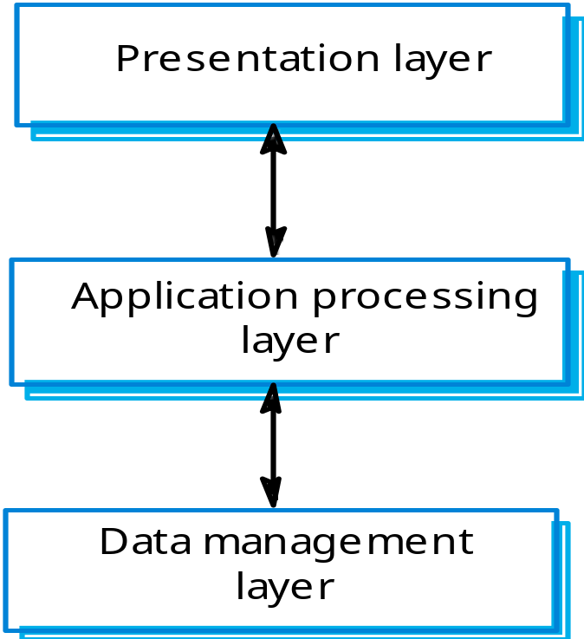
Application Layers (Cont’d)

Slide 6
Types of Client-Server Architectures
Two-tier
  The three application layers are mapped onto two computer systems – the client and the server.
  Client can be
    Thin client; or
    Fat client
Three-tier
  The three application layers are mapped onto three logically separate processes that executes on different processors.

Slide 7
Thin and Fat Clients
Thin-client model
  In a thin-client model, all of the application processing and data management is carried out on the server. The client is simply responsible for running the presentation software.
Fat-client model
  In this model, the server is only responsible for data management. The software on the client implements the application logic and the interactions with the system user.

Slide 8
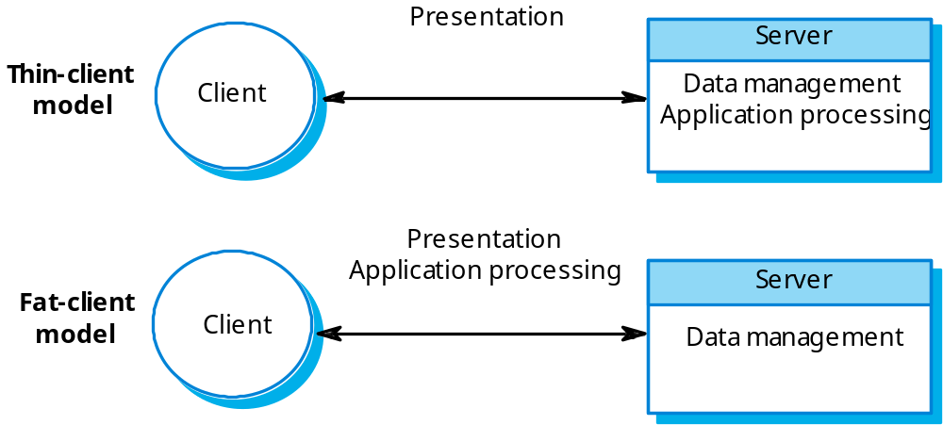
Thin and Fat Clients (Cont’d)

Slide 9
Thin-Client Model
Used when legacy systems are migrated to client server architectures.
  The legacy system acts as a server in its own right with a graphical interface implemented on a client.
A major disadvantage is that it places a heavy processing load on both the server and the network.

Slide 10
Fat-Client Model
More processing is delegated to the client as the application processing is locally executed.
Most suitable for new C/S systems where the capabilities of the client system are known in advance.
More complex than a thin client model especially for management. New versions of the application have to be installed on all clients.

Slide 11
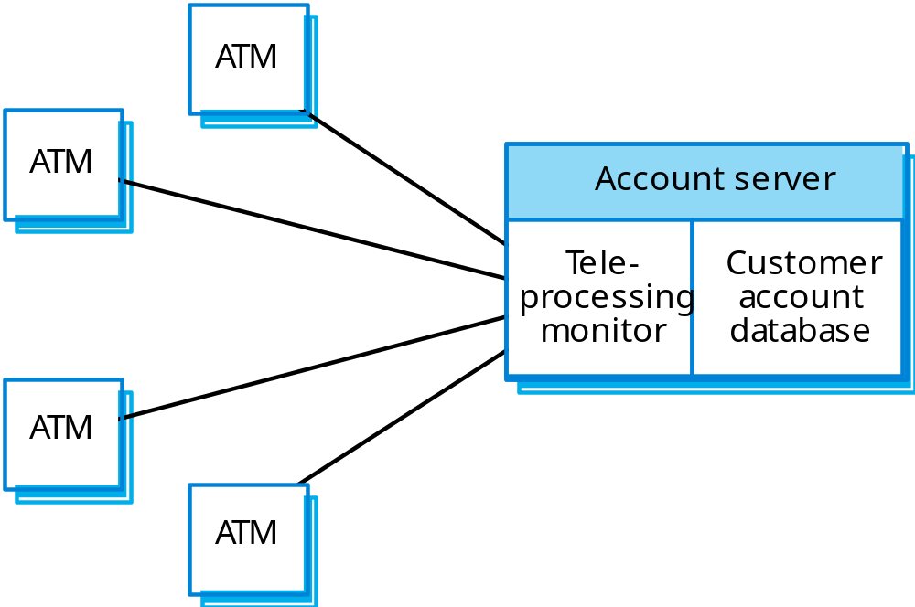
A Client-Server ATM System

Slide 12
Three-Tier Architecture
Each of the application layers may execute on a separate processor.
Allows for better performance than a thin-client model and is simpler to manage than a fat-client model.
A more scalable architecture - as demands increase, extra servers can be added.

Slide 13
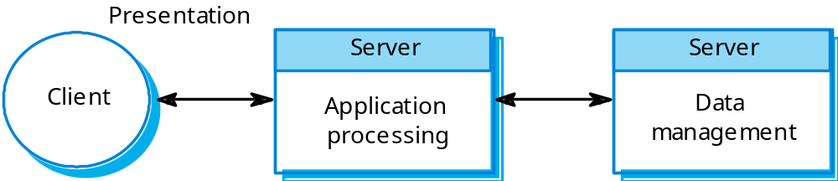
A 3-tier Client-Server Architecture

Slide 14
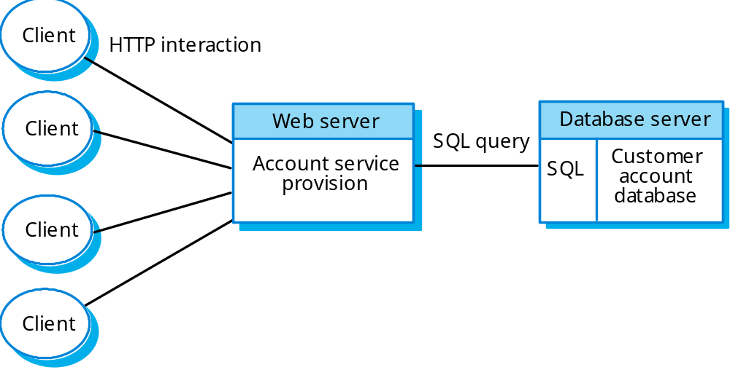
An Internet Banking System

Slide 15
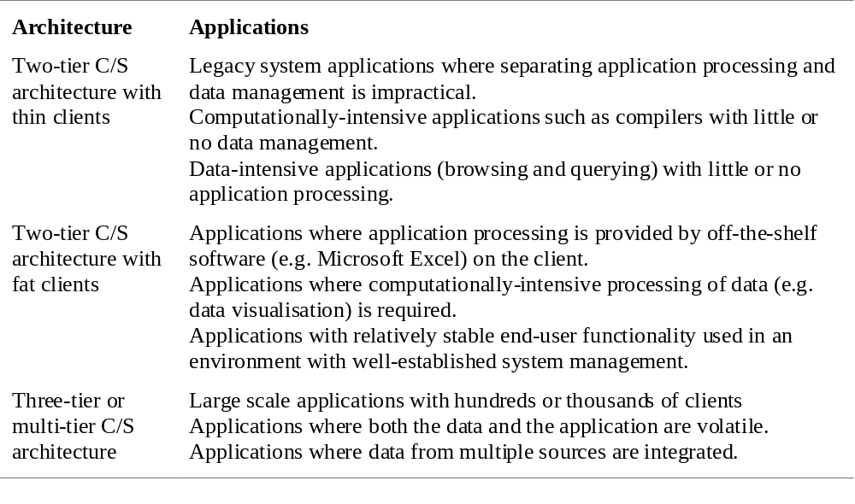
Use of Client-Server Architectures

Slide 16
Summary
Tow basic client-server architecture
  2-tier
    Thin client: all of the application processing and data management is carried out on the server
    Fat clients: run some or all of the application logic.
  3-tier
    Allows for better performance than a thin-client approach and is simpler to manage than a fat-client approach.

